Slide 1
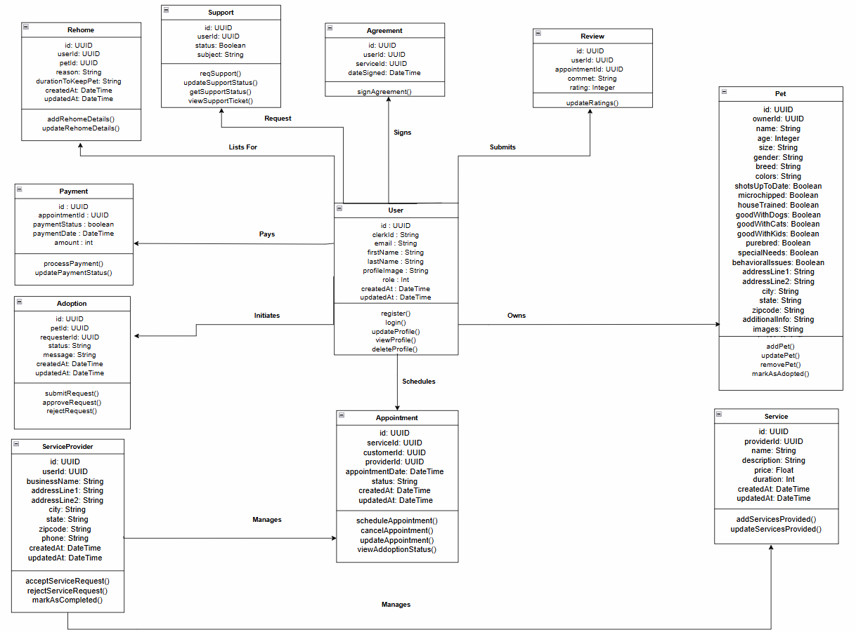
Class Diagram (Hearts and Paws)
Notes:
Add Id, userId, PetId, HomeSituation in adoption,

